Slide 1
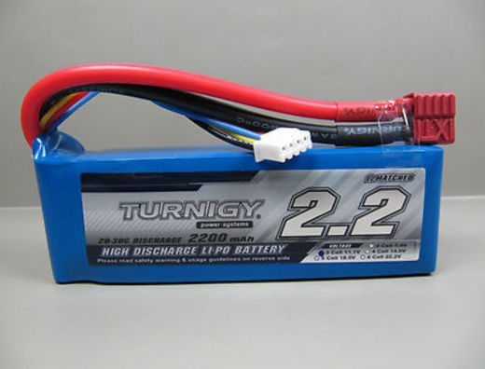
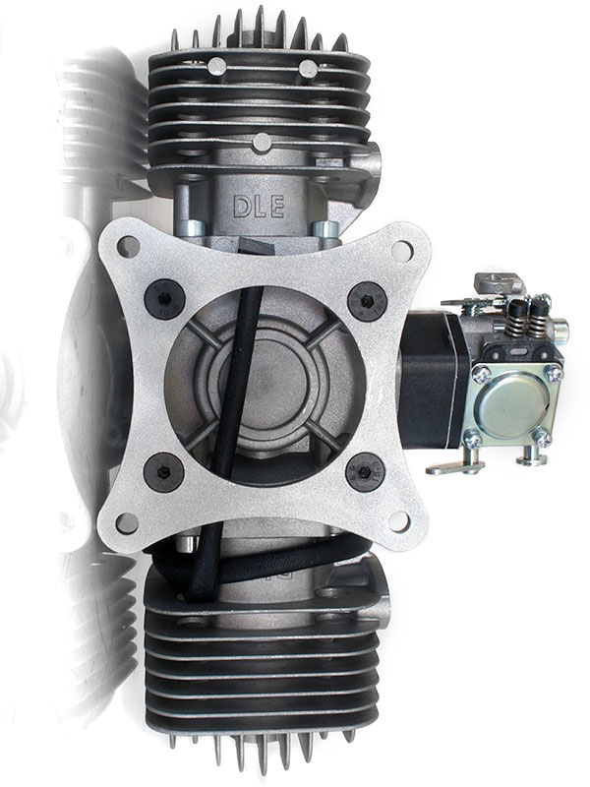
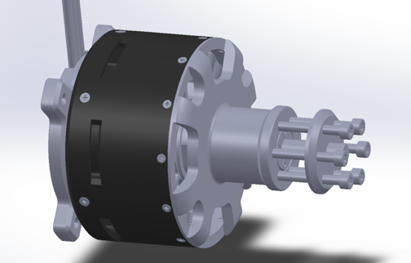
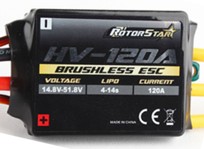

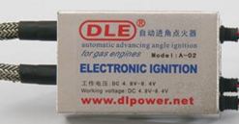
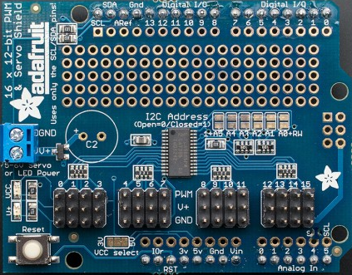
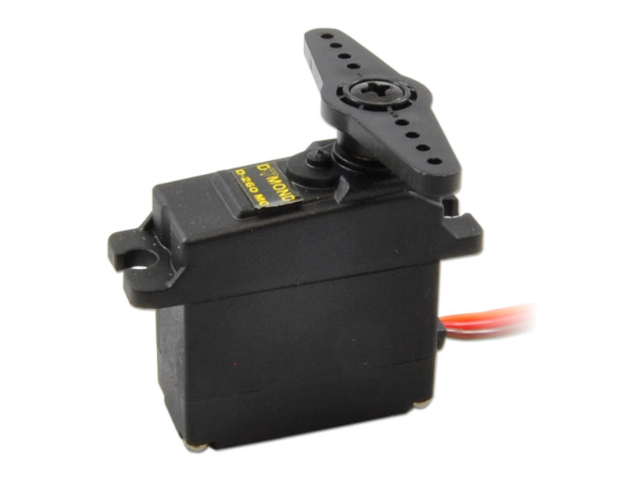
Ignition #1
Generator Circuit
To Rectifier Circuit
Turnigy 5000 mAh LiPo
DLE-60 Twin Engine
44.4V
Motor Power
Shaft Coupler
5V
Rotorstar 120A ESC
Turnigy 80cc Outrunner BLDC
10A 6S Castle BEC
5V
RPM (tach) Signal
Ignition Box
Ignition #2
TSX35 Servo #2
Adafruit Servo Shield
TSX35 Servo #1

Slide 2
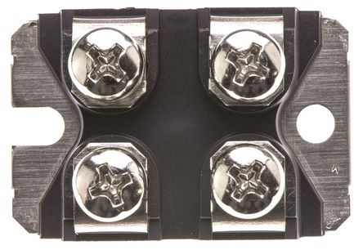
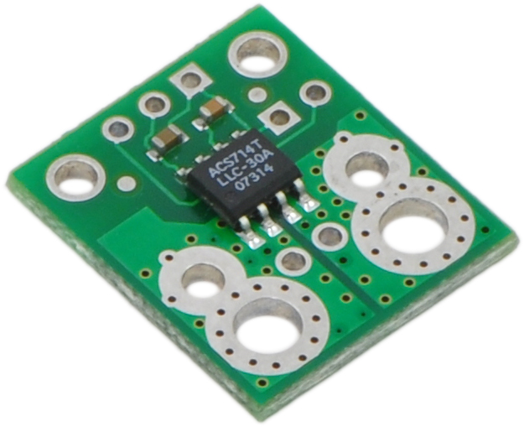
Rectifier Circuit
From generator circuit
GSXD120A Schottky Diode
GSXD120A Schottky Diode
GSXD120A Schottky Diode
Allegro ASC712 Current Sensor
Turnigy 5000 mAh LiPo

Slide 3


GSXD120A Schottky Diode
GSXD120A Schottky Diode
GSXD120A Schottky Diode
OUT +
OUT -

